Slide 1

Fake news detection
BY--- ANKITA SRIVASTAVA

Slide 2
Introduction
Fake news's simple meaning is to incorporate information that leads people to the wrong path. Nowadays fake news spreading like water and people share this information without verifying it. This is often done to further or impose certain ideas and is often achieved with political agendas.

Slide 3
Preprocessing of Data
We have performed the following preprocessing on the data:
Removed punctuations
Removed the stop words
Applied counter vectorizer

Slide 4
Natural language processing
Machine learning data only works with numerical features so we have to convert text data into numerical columns. So we have to preprocess the text and that is called natural language processing.
In-text preprocess we are cleaning our text by steaming, lemmatization, remove stopwords, remove special symbols and numbers, etc. After cleaning the data we have to feed this text data into a vectorizer which will convert this text data into numerical features.

Slide 5
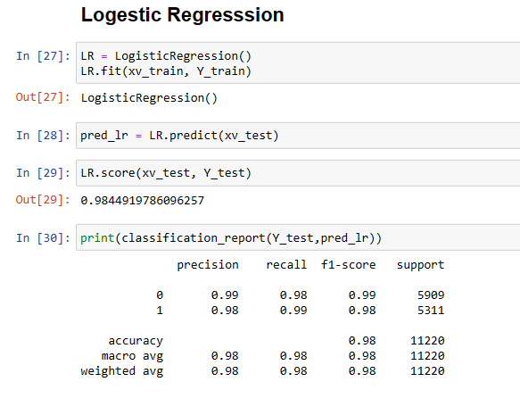
DATA MODELING

Slide 6
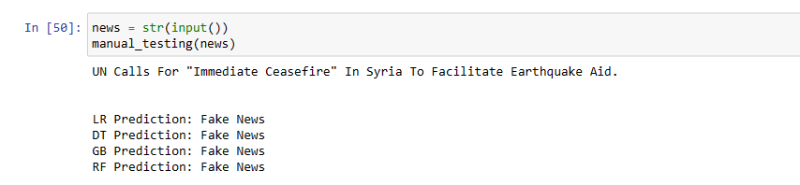
Data Visualization

Slide 7
References
1-https://www.javatpoint.com/nlp
2-https://www.educative.io/answers/preprocessing-steps-in-natural-language-processing-nlp
3-https://www.youtube.com/watch?v=5ctbvkAMQO4
4-https://www.youtube.com/watch?v=X2vAabgKiuM

Slide 8
Thank you

